Slide 1

Slide 1
Presentation for the Departmental Store Management and Procurement team on Suggestions for Women Shoe Store
Trishala Basti
Data Scientist

Slide 2
PRESENTATION TO Managers and Procurement Team
Business Case:
=========
The CEO "Mr. James Disouza" of a department store chain "Metro Spencers" wants to expand a new chain dedicated to Women Shoes.
As a Data Scientist, I have collected the data on latest market trend in the Womens' Shoes .
Based on my findings, this presentation is to the Deparmental Store Chain “Metro Spencers” Management team to help them planning the orders of Women Shoes to host them in the stores.
The store manager will have a task to look at the specific details on the combination of brands, colors and cost of the shoes.
Later we will advise the Procurement team who has will get this as Project details from Managers on the Women Shoe Products to be ordered.

Slide 3
Important features for The managers to deal with
Women Shoe Store Business
The managers have identified the directions on which the orders has to be placed from the right brands based on the results provided by the Data Scientist. Now this presentation will give more insights to the Procurement team to make right orders to host in the shoe store.
COLORS
COST
BRAND

Slide 4
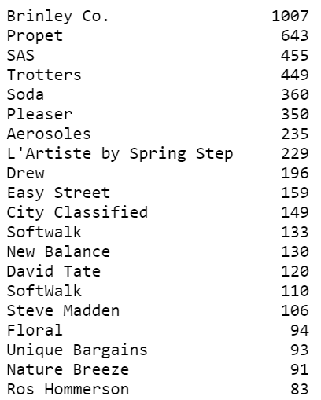
Most selling brands
The top selling colors must be orderd from the top selling brands as listed in the left.
We will see in the next slide the top brands with the top selling colors.

Slide 5
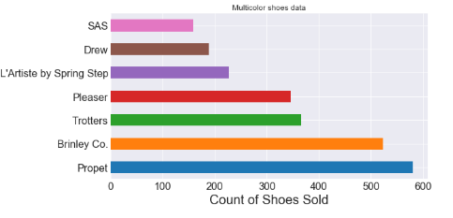
Suggestion to order Multicolor shoes from brands
The above is the top 7 brands in which multicolor shoes were sold the most. Hence, the Multicolor shoes can be ordered from the Brands Propet, Brinley Co., Trotters the most.

Slide 6
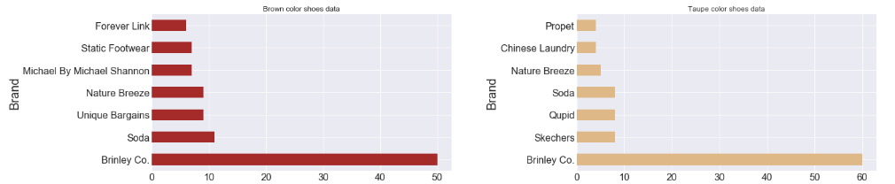
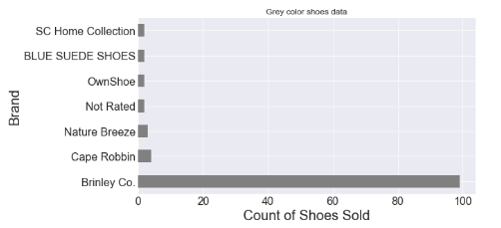
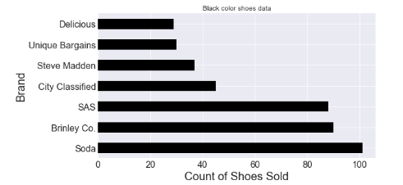
From the above, we find that the brand Brinley Co. is quite famous in certain colors like Black, Grey, Brown and Taupe. The above graph also displays other famous brands selling these colored shoes like “Nature Breeze, Soda, SAS, Unique Bargains and so on.

Slide 7
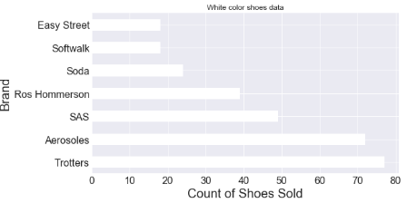
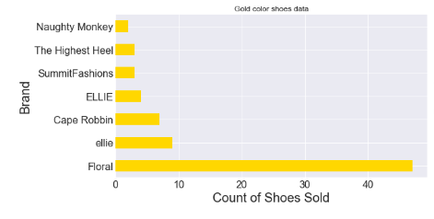
From the above graphs we can say that :
White colored shoes and Gold colored shoes are not having great sales counts from Brand Brinley Co brand (compared to previous data on different colors)
These colors have different brands serving the customers perseverance.
White can be mostly ordered from brands Trotters, Aerosales and SAS.
Gold colored shoes can be mostly ordered from brand Floral.
HENCE IT IS IMPORTANT TO ORDER DIFFERENT COLORS FROM THEIR MOST SELLING BRANDS.

Slide 8
Price ranges to look for
Low Range
Mid Range
High Range

Slide 9
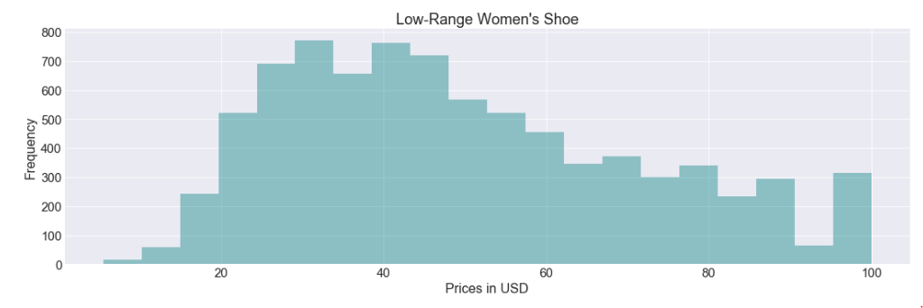
Low range (20 usd to 100 usd)
For volume business the store should have costing from 20 USD to 100 USD. The total customer count in this range is : 8246
As seen in the graph, specifically the store should host a major amount of shoes in the range 30 USD to 50 USD. This will give the highest volume business

Slide 10
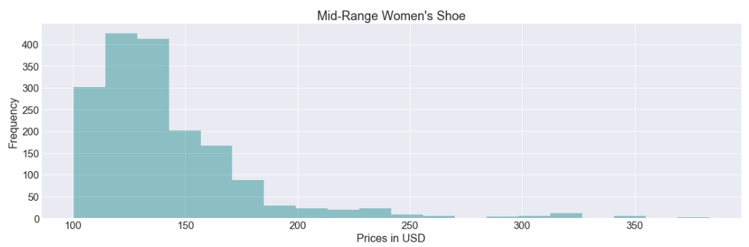
Mid Range (100 usd TO 500 USD)
The customers in this range are just 17% equaling around : 1736 counts.
Not many of the shoes has to be in the store in this range. Ideally the mid range value of 100 USD to 150 USD shoes will attract more customers.

Slide 11
High range (500 usd TO 5000 USD)
Exclusive counted customers around 18.
The highest shoe prize sold in this range is 5000 USD which is a case of Pride of Ownership
The store may not benefit much with hosting these shoes.
If the store wants to host in this range, they can keep a counted of 5 shoes in the range of 500 USD to 1000 USD

Slide 12
Hence the managers have to keep the Brand, Colors and Prices combination in mind and next ask the teams to make necessary orders based on the Brand color and price combinations.
The manager should talk to the team and assign individual team members to get shoes with specific color and costs in the store.

Slide 13
Suggestion to the procurement team
The managers have identified the directions on which the orders has to be placed from the right brands based on the results provided by the Data Scientist. Now this presentation will give more insights to the Procurement team to make right orders to host in the shoe store.
The procurement team can start making more orders from the high selling brands and with the cost range specifically in 20$ to 80$
The procurement should also look at the next data visuals to get more deeper understanding while ordering for colors in price range. Not all the colors of shoe have the same price ranges sold out.

Slide 14
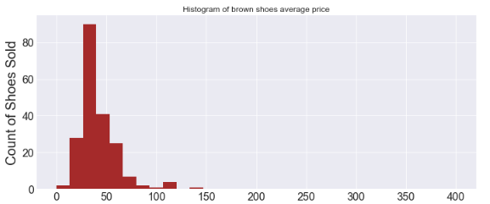
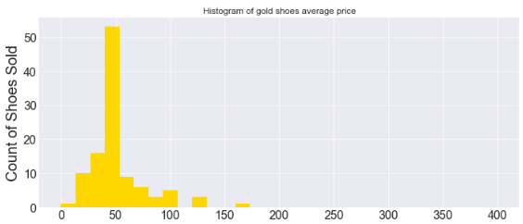
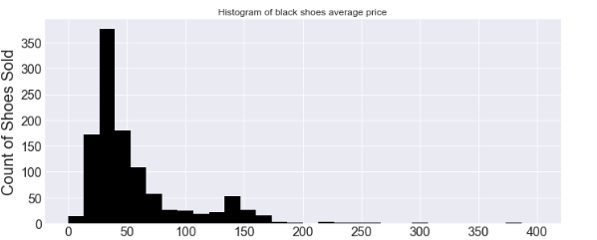
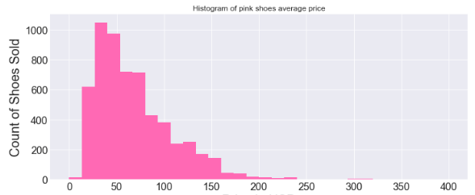
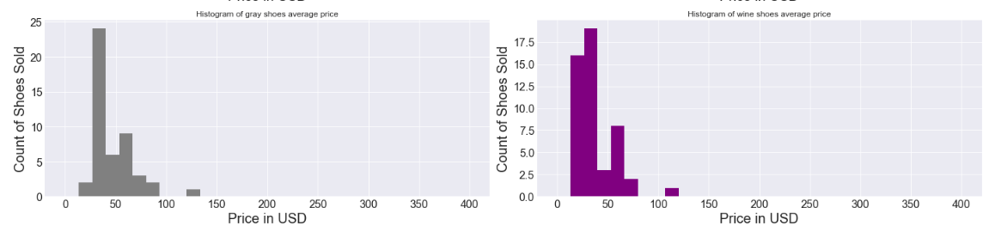
As seen in the above graphs, the procurement team should order shoes of colors Multicolor, Black, Brown, Gold and Grey in range between 20 USD to 80 USD for high volume gains.
Wine Color shoes should be more in the range of 20 USD to 40 USD for volume business.
Black and Multicolor has some decent volume gains in the rainge 100 USD to 170 USD. And few in this range can be ordered.

Slide 15
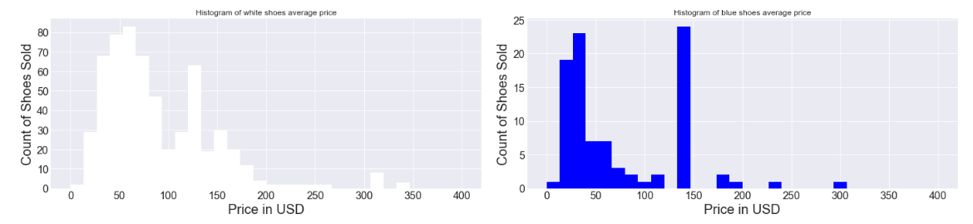
From the above graph we can find that, the white and blue shoe color has some good business even in the range of 100 USD to 150 USD.
White color has huge presence in the range of 30 USD to 70 USD. And quite a good presence in the range of 120 USD to 130 USD.
Blue color is mostly doing good in the range 20 USD to 50 USD. And amazingly around 130 USD to 150 USD.
These ranges in white and blue color orders of the shoes can be done by the procurement team.

Slide 16
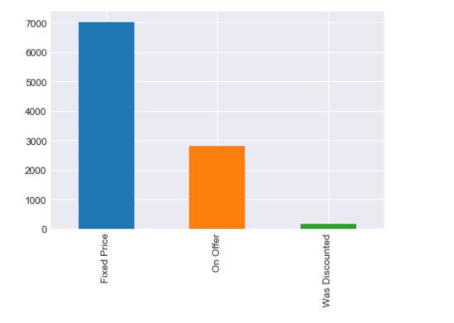
Discounts versus fixed price to the store managers and team
The procurement team should try to make deals and orders with the brands in such a way that they should try to sell the products in the store with the Fixed price.
Reason: As seen from the graph around 7000+ shoes are sold with fixed price and less than 3000 are sold on offer.

Slide 17

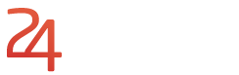
Slide 10
THANK YOU

